Slide 1

Two-Agent Leader/Follower Formation Control
Through Challenging Maneuvers and Limited Sensing Environments
Boston University ME/SE 740 Final Project
James Dunn
April 25, 2019
Code: github.com/jimmykdunn/raspi_car

Slide 2
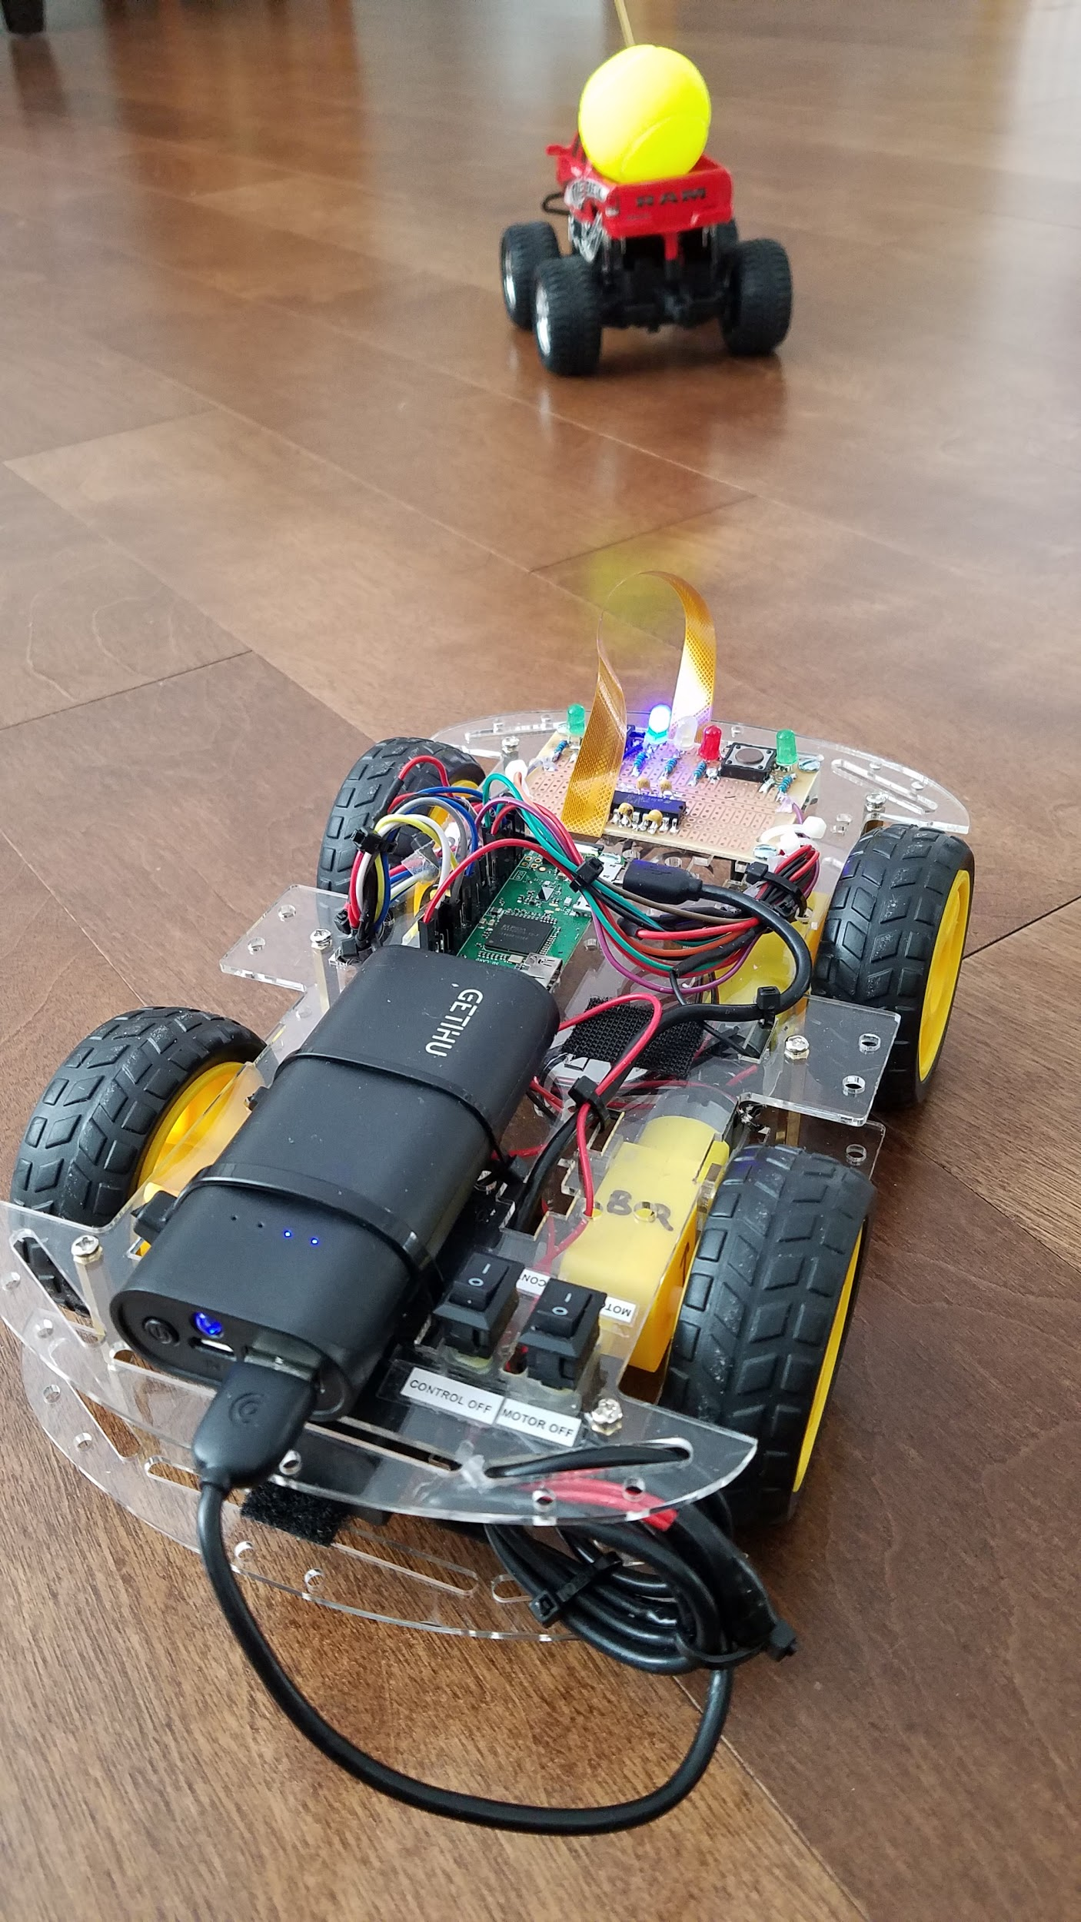
Objective
Build and program a 2-agent leader/follower team of robotic cars
Leader is controlled manually
Follower stays a set distance behind leader
Follower is autonomously controlled using only an onboard camera and processor
Approaches in the literature use additional sensors, off-board processing, and/or leader control communication to the follower

Slide 3
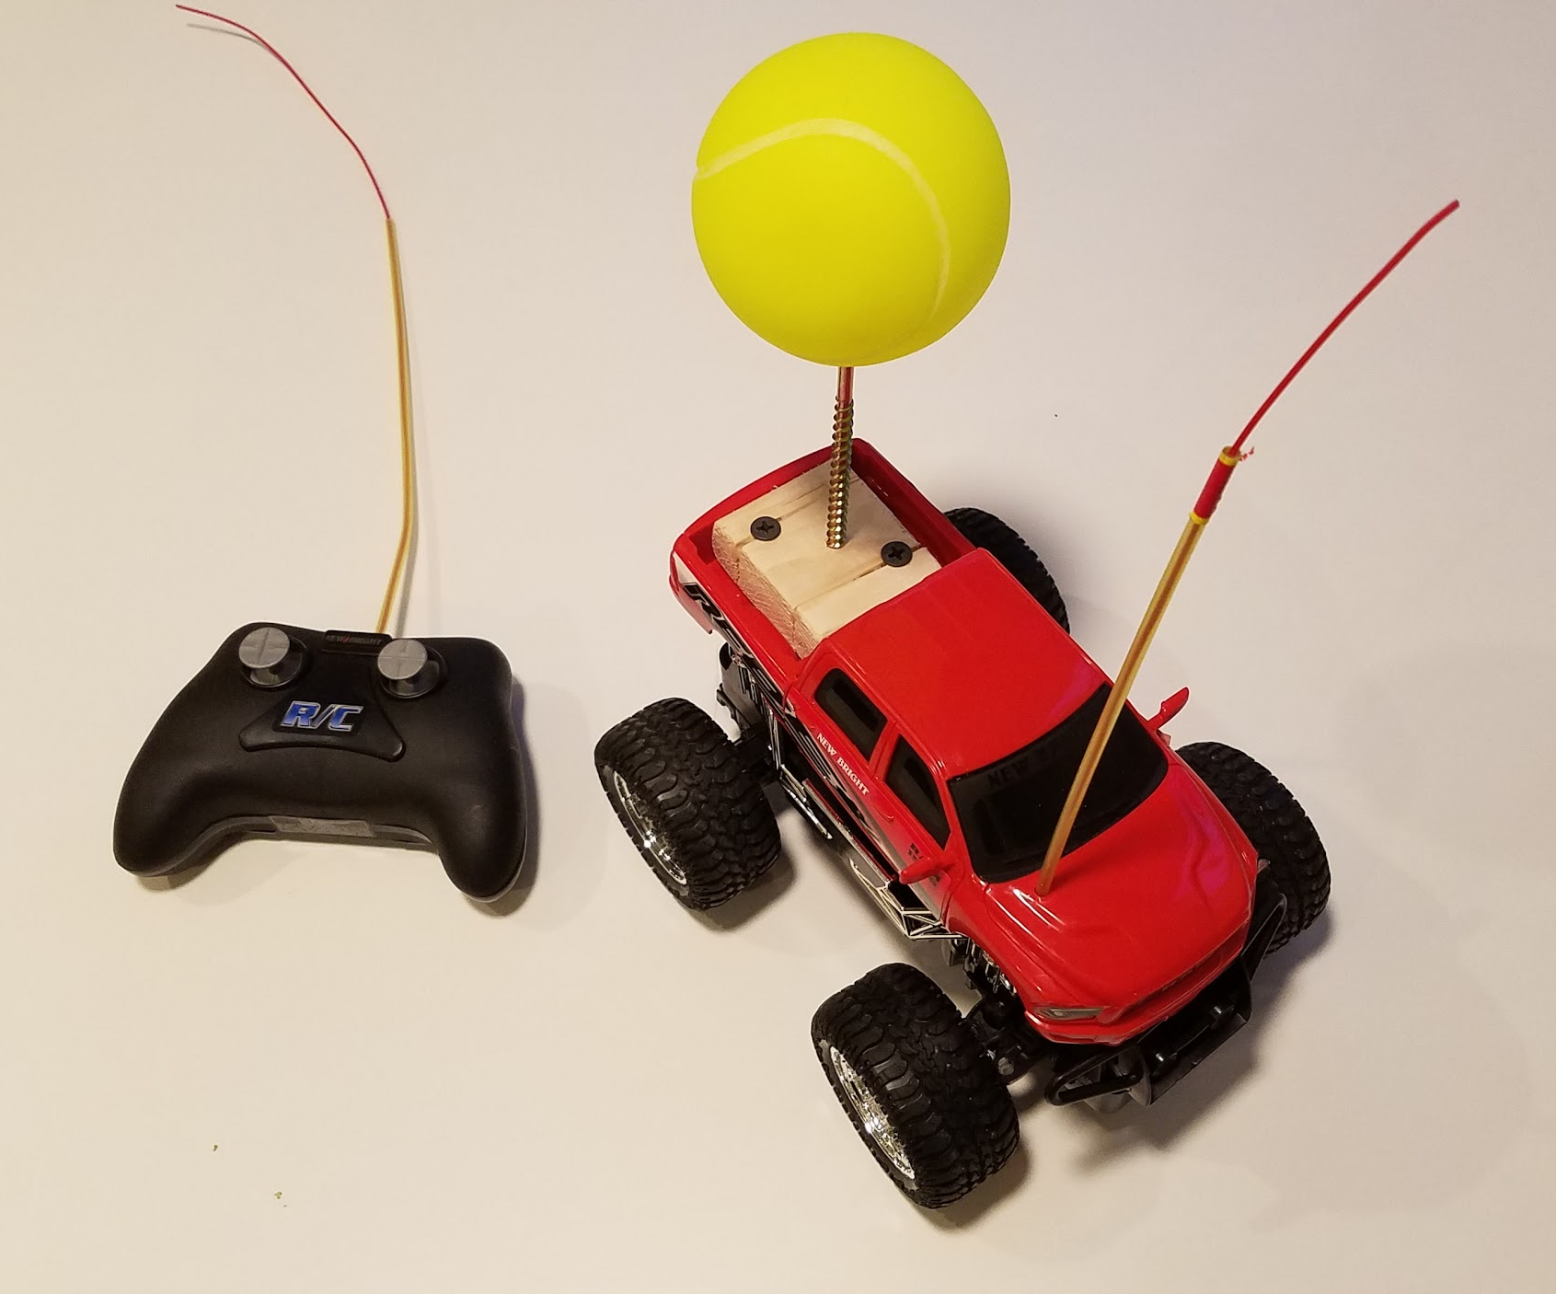
Lead Agent
Basic COTS RC truck
Manually driven
Bright yellow ball used as fiducial
Minimizes image processing
Lambertian surface: similar brightness regardless of view angle
Known size gives a range measurement
Not optimal
Much faster than following agent
Binary steering and throttle controls
Difficult to drive

Slide 4
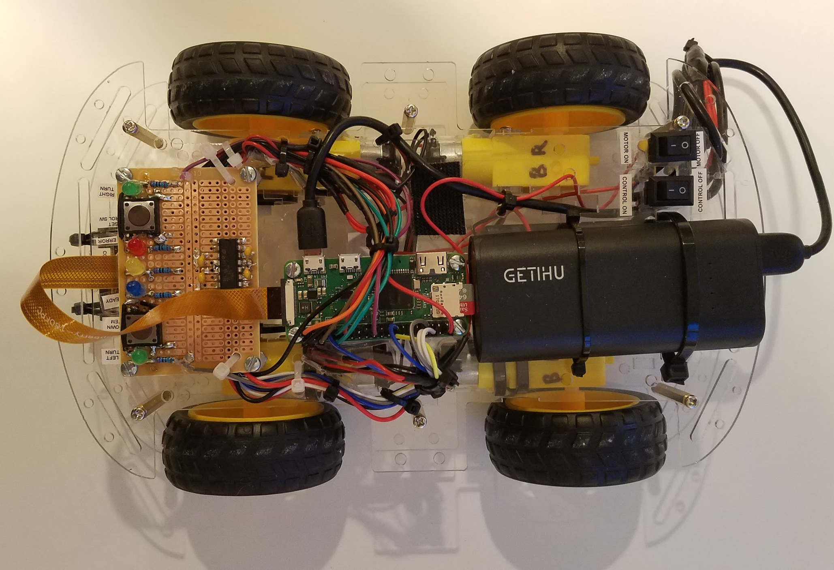
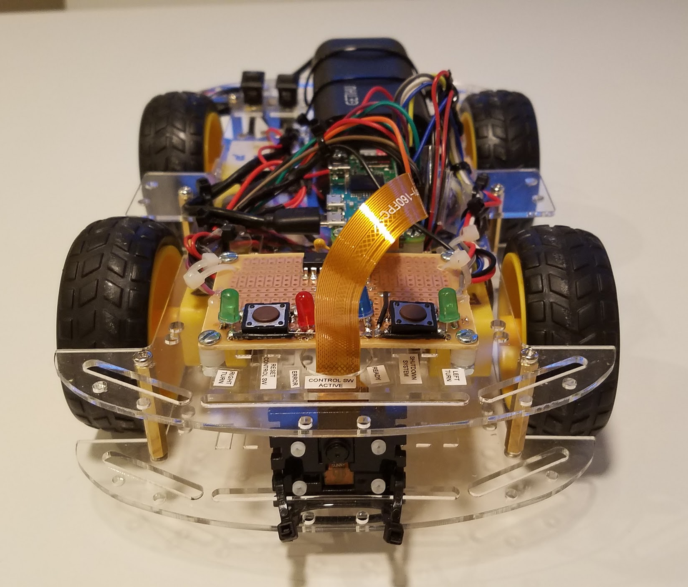
Following Agent
Intentionally low cost, small, light, and low-power
All processing done onboard
Hand-built using the following parts
Hobbyist car chassis
Raspberry Pi Zero W (Raspbian OS) + 64GB SD card
RGB camera
L293D motor driver
4x motor and wheel assemblies
5V rechargeable battery for Raspberry Pi
9V alkaline battery to run motors
Switches, LEDs, resistors, capacitors, circuitboard, buttons, solder, wires, hot melt glue, cable ties, velcro

Slide 5
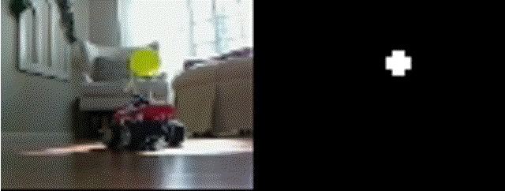
Lead Agent Detection
HSV (hue-saturation-value) is the ideal colorspace for thresholding the mask
Too computationally expensive!
Instead use a custom mapping from native RGB pixels to “yellowness”, and threshold
Declare most yellow pixel the target location
Convert location to azimuth angle, 𝜃
Declare all nearby pixels above a threshold as part of the leader
Convert area of leader to range in meters, r

Slide 6
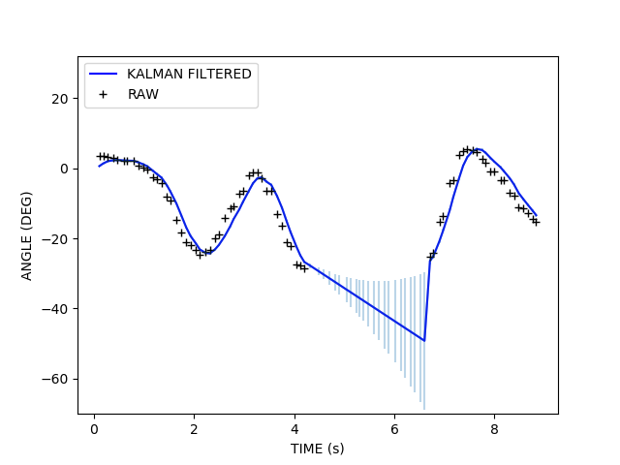
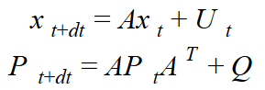
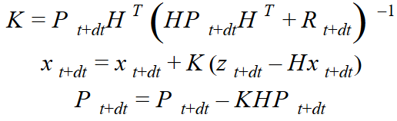
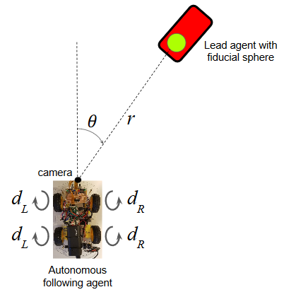
Feedback Control
Apply Kalman filter to range and angle, x=(r,𝜃)
Smooths out controls based on measurement errors
Makes robust to target leaving FOV, outages
Convert filtered (r,𝜃) to best left and right wheel speed to maintain formation
Wheel speed controlled by pulse-width-modulation duty of voltage applied to motor, (d_{R},d_{L})
Project forward
Use measurement (z) to update

Slide 7
Challenges Overcome
Limited Field of View (FOV): +/- 25°
When leader turn sharply, it leaves follower’s FOV
Kalman filter predicts leader location, following agent continues turning
Limited Processing
Raspberry Pi Zero W has just a single core 1 GHz processor and 512MB RAM
Downsample imagery to 80x60 pixels to maintain framerate > 10Hz
Dynamic Lighting
Camera’s dynamic range is limited - fiducial sphere can appear bright or dim
Custom “yellowness” metric (faster than HSV)
Sporadic Missed Detections
Can be caused by lighting, obscurations, processor hiccups
Kalman filter allows following agent to “coast” through them

Slide 8
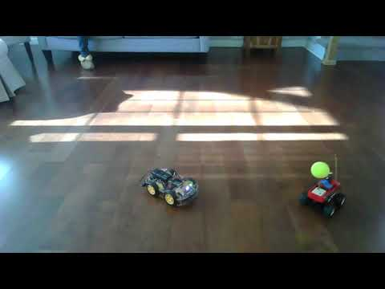
Final Performance Demonstration
https://www.youtube.com/watch?v=I33543QSVlE

Slide 9
Final Performance Demonstration

Slide 10
Benefit of the Kalman Filter
WITHOUT KALMAN FILTER
WITH KALMAN FILTER

Slide 11
Conclusions
Leader-follower formation control worked!
Raspberry Pi Zero W limiting, but satisfactory
All processing done onboard
10-15 Hz framerate maintained
Much more robust with Kalman filter
Robust to sharp turns out of the following agent’s FOV
Robust to sporadic outages
Similar hardware setup could be used on small quadcopters

Slide 12
Related Work
Kwany-Kyo-Oh, Myoung-Chul Park, Hyo-Sung Ahn, “A survey of multi-agent formation control”, Automatica 53, pp 424-440, 2015
Gian Luca Mariottini et al, “Vision-Based Localization for Leader–Follower Formation Control”, IEEE Transactions on Robotics, Volume 25, Issue 6, 2009
Luca Consolini, Fabio Morbidi, Domenico Prattichizzo, Mario Tosques, “Leader–follower formation control of nonholonomic mobile robots with input constraints”, Automatica, Volume 44, Issue 5, 2008
M. Hassan, E. Aljuwaiser, R. Badr, “A new on-line observer-based controller for leader-follower formation of multiple nonholonomic mobile robots”, Journal of the Franklin Institute, Vol 355, Issue 5, 2018
R. Hogg, A. Rankin, M. McHenry, D. Helmick, C. Bergh, S. Roumeliotis, and L. Matthies, “ Sensors and Algorithms for Small Robot Leader/Follower Behavior”, Proc. SPIE 4364, 2001
R Cruz-Morales, M, Velasco-Villa, R Castro-Linares, and E Palacios-Hernandez, “Leader-Follower Formation for Nonholonomic Mobile Robots: Discrete-Time Approach”, International Journal of Advanced Robotic Systems, Vol 13, Issue 2, 2017
www.bzarg.com, “How a Kalman Filter Works, in Pictures”, https://www.bzarg.com/p/how-a-kalman-filter-works-in-pictures/, accessed 4/12/19

Slide 13
Thank you!

